Slide 1

Assignment for Meeting 1
Bradley Krakar

Slide 2
Objective
The objective was to learn the basics of several important python libraries as well as to get a better understanding of the data we will work with

Slide 3
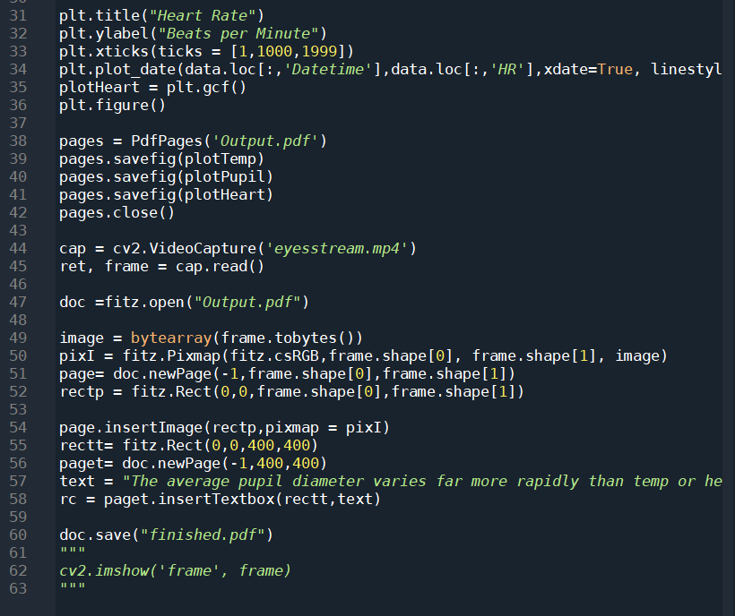
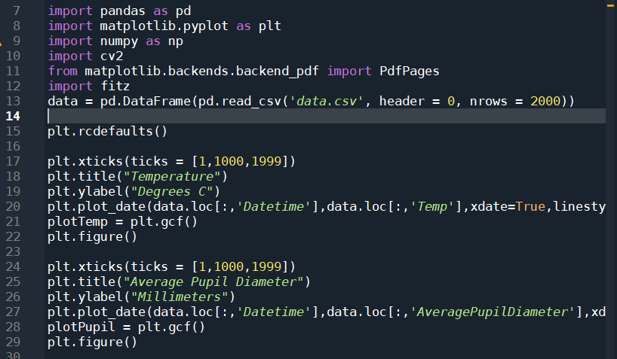
Code:

Slide 4
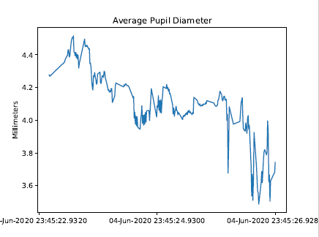
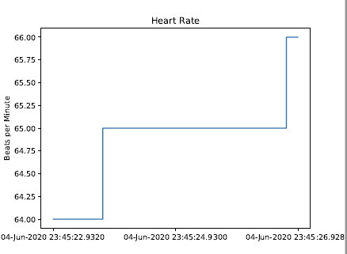
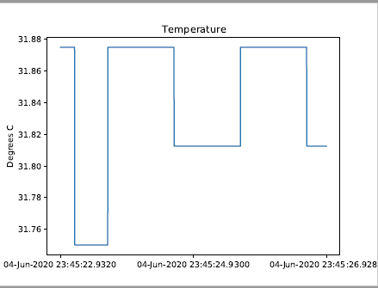
Plots

Slide 5
Challenges
Working with python for the first time
Figuring out how to get the open cv image into the pdf was difficult
Ultimately easier than expected for having not used python before

